Slide 1


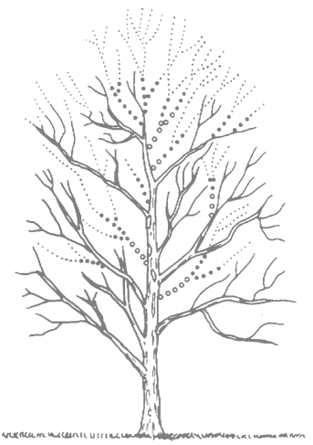
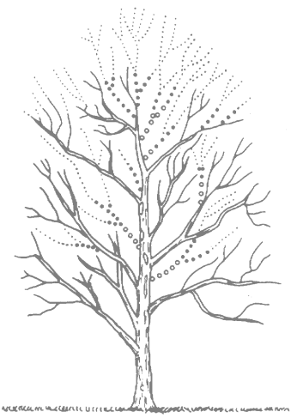
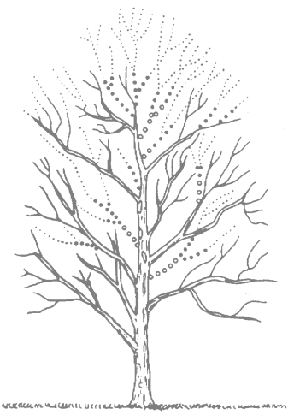
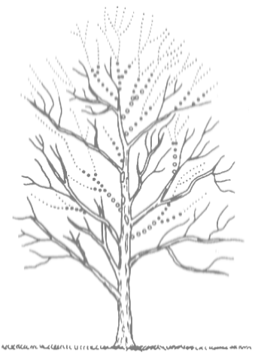
MSR Cambridge
Spectral Kernels for Probabilistic Analysis and Clustering of Shapes
Loic Le Folgoc, Aditya Nori, and Antonio Criminisi

Slide 2
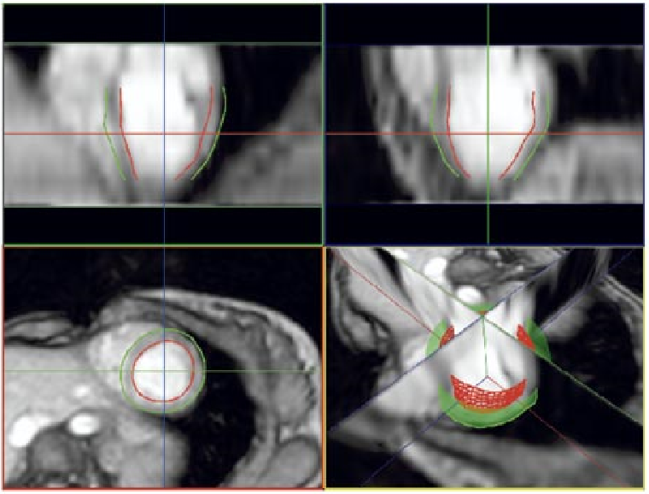
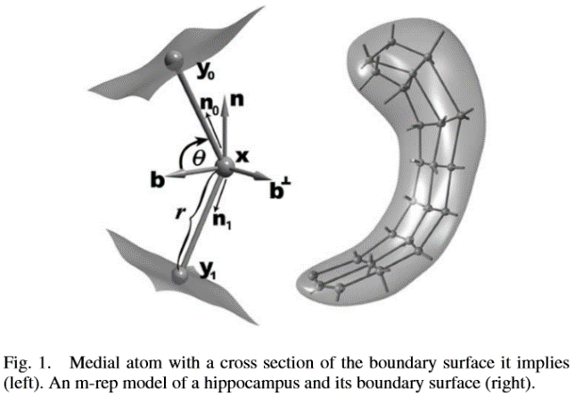
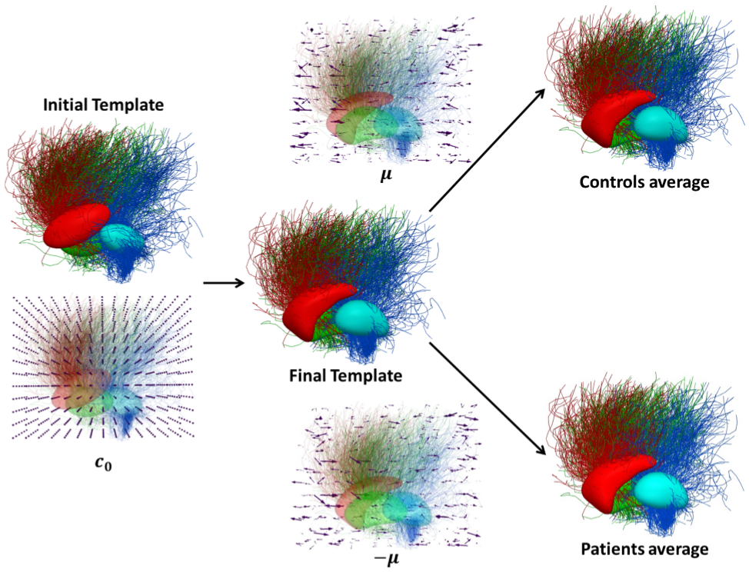
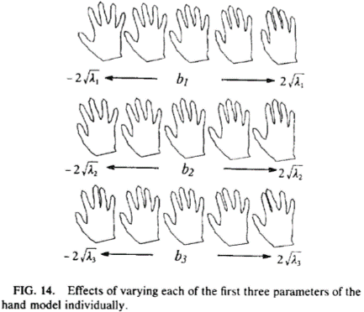
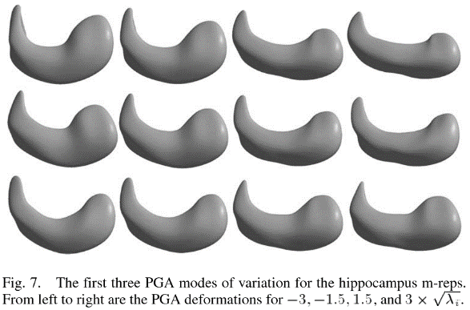
Statistical Shape Analysis: statistics in non Euclidean spaces (hard!)
Active Shape/Appearance Models
Medial representation & PGA
Diffeomorphometry
[Top] Mitchell et al. 3D active appearance models: segmentation of cardiac MR and US images, IEEE TMI 2002
[Right] Cootes et al. Active Shape Models, CVIU 1995
[Image] Gori et al. A Bayesian framework for joint morphometry of surface and curve meshes in multi-object complexes, MedIA 2017
Joshi et al. Multiscale deformable model segmentation and statistical shape analysis using medial descriptions, IEEE TMI 2002
[Images] Fletcher et al. Principal Geodesic Analysis for the study of nonlinear statistics of shape, IEEE TMI 2004
How to work around the non-trivial data type?

Slide 3
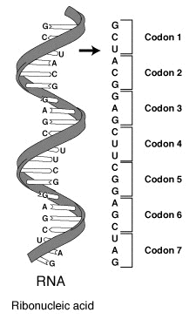
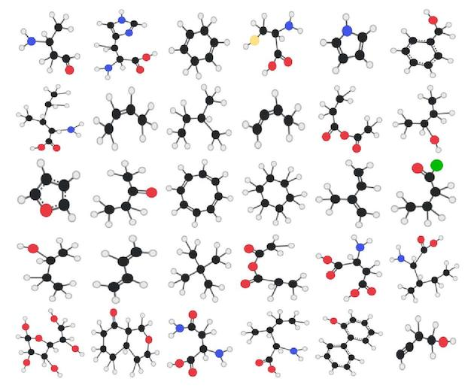
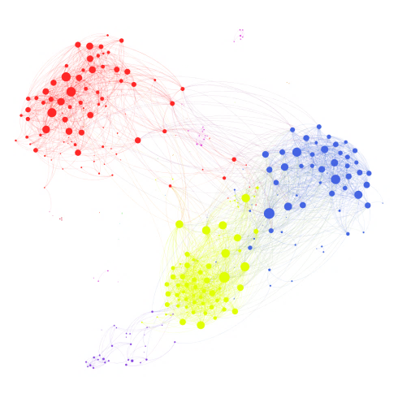
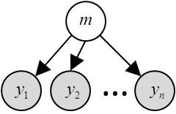
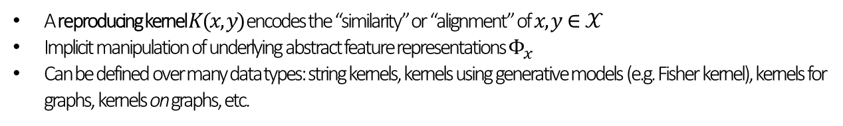
How to cluster dataset elements for non-trivial data types?
DNA sequences (strings)
Proteins, chemical compounds (graphs)
Individuals in a network (graph nodes)
Observations w/ generative model
From VBA toolbox
From Wikipedia
Adapted from Gephi
From github/chemplexity
A reproducing kernel $K(x,y)$ encodes the “similarity” or “alignment” of $x,y∈𝒳$
Implicit manipulation of underlying abstract feature representations $Φ_{x}$
Can be defined over many data types: string kernels, kernels using generative models (e.g. Fisher kernel), kernels for graphs, kernels on graphs, etc.
Contribution #1. Probabilistic mixture of PCA in kernel space

Slide 4
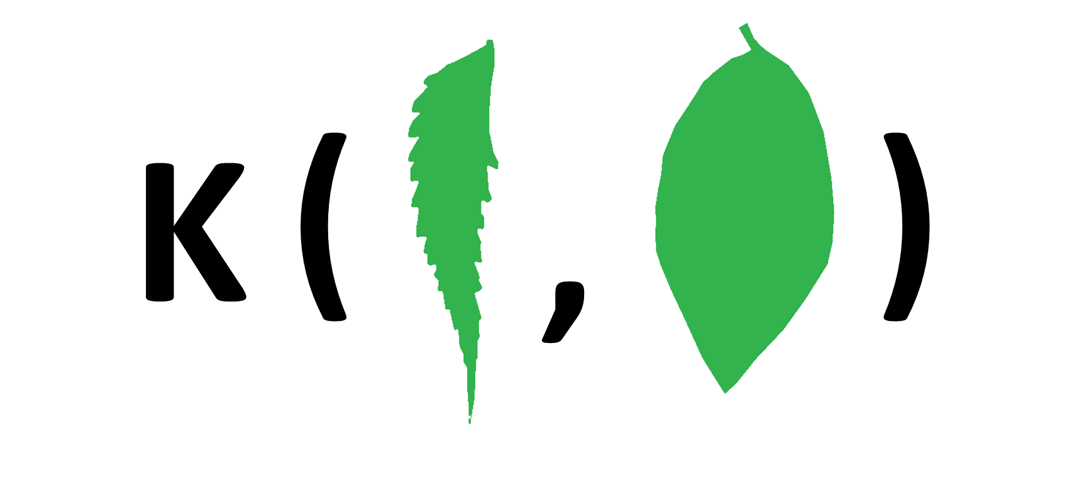
Define reproducing kernels over shapes?
Contribution #2. Parametric family of Shape Spectral Kernels
Properties
Based on spectral shape analysis
Generalizes existing metrics such as shape DNA [1], WESD [2]
Invariant to object pose
Ease of use, correspondence free
Adjustable importance of global and local shape features
[1] Reuter et al. Laplace-Beltrami spectra as Shape DNA of surfaces and solids, CAD 2006
[2] Konukoglu et al. Weighted Spectral Distance for measuring shape dissimilarity, IEEE PAMI 2013

Slide 5
Outline
Background on reproducing kernels
Probabilistic mixture of PCA in kernel space
Building shape spectral kernels

Slide 6
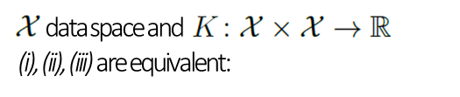
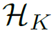
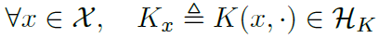
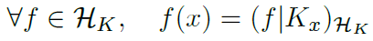
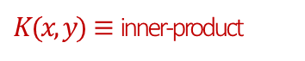
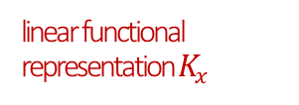
Reproducing kernels
A construct to replace non-linear statistics on complex data types by linear statistics on functional representations
K is positive definite, i.e.
There exists a Hilbert space such that
There exists a Hilbert space and a feature map such that
Gram matrix encodes everything about data
linear functional representation $K_{x}$
$K(x, y)≡$ inner-product

Slide 7
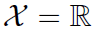
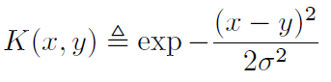
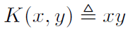
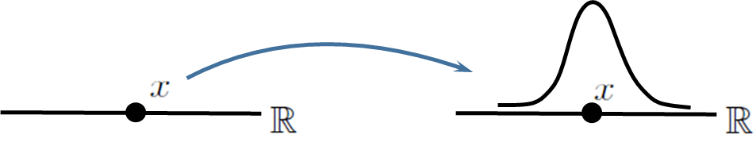
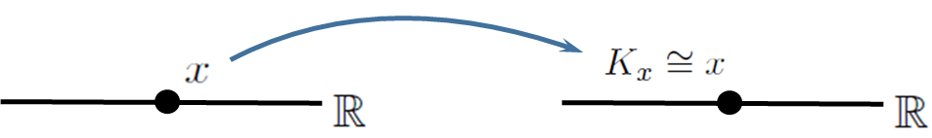
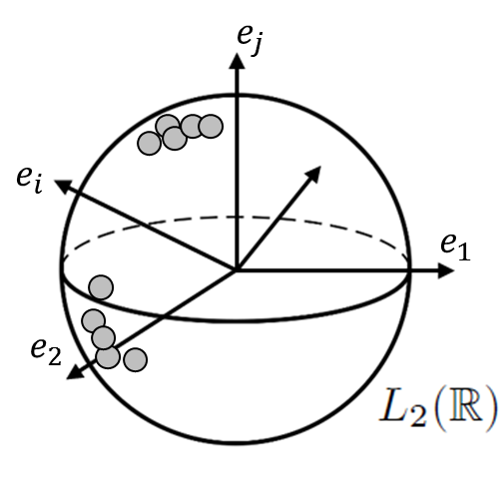
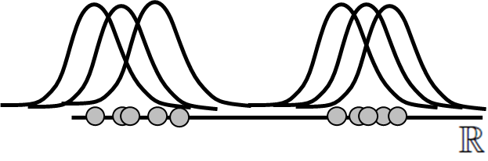
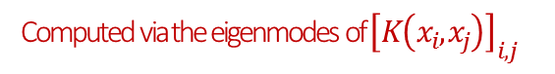
Reproducing kernels
A construct to replace non-linear statistics on complex data types by linear statistics on functional representations
Examples for
Linear kernel
Exponential kernel
Example: PCA
Computed via the eigenmodes of ${\left[K\left(x_{i},x_{j}\right)\right]}_{i,j}$

Slide 8
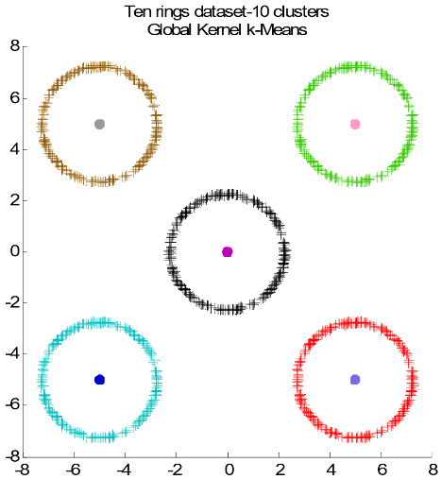
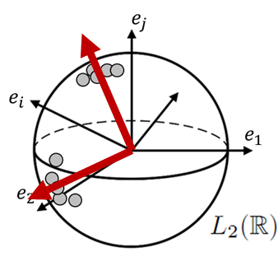
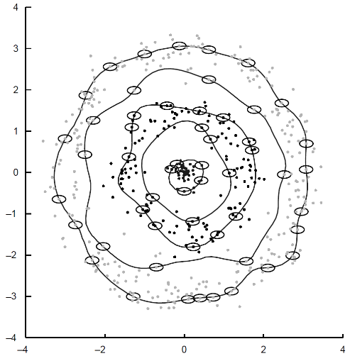
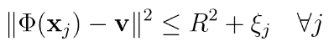
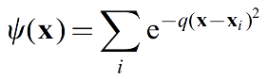
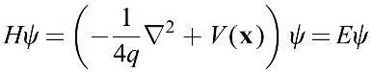
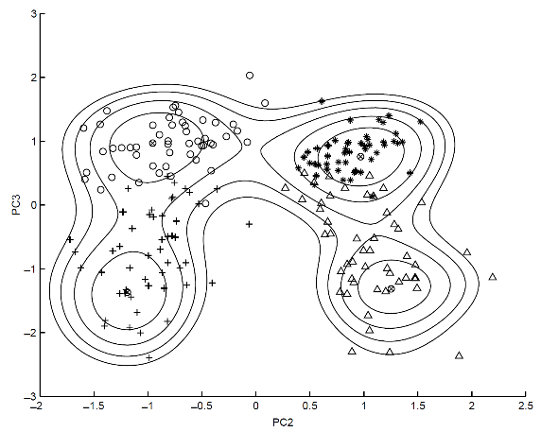
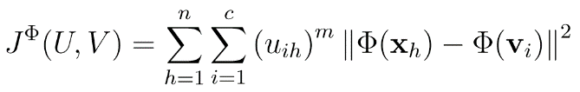
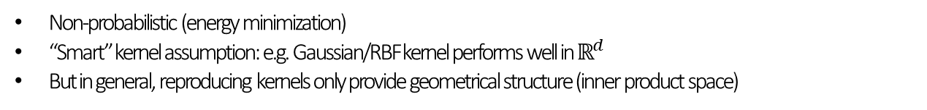
Kernel clustering algorithms^{[1]}
Kernel K-Means & Fuzzy c-Means
(Sparse) Kernel PCA
Support Vector Clustering, quantum clustering
[From] Tzortzis and Likas. Global kernel k-Means, IJCNN 2008
[From] David Horn. Clustering via Hilbert space, Physica 2001
Non-probabilistic (energy minimization)
“Smart” kernel assumption: e.g. Gaussian/RBF kernel performs well in $ℝ^{d}$
But in general, reproducing kernels only provide geometrical structure (inner product space)
Bayesian mixture of kernel PCA / Gaussians?
[1] Filippone et al. A survey of kernel and spectral methods for clustering, Pattern Recognition 2008.

Slide 9
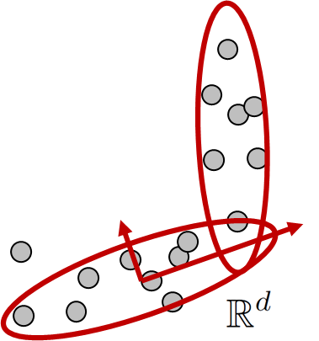
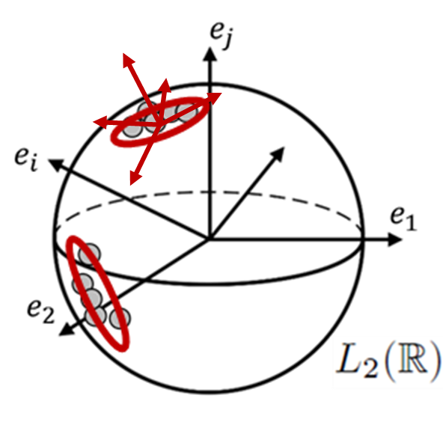
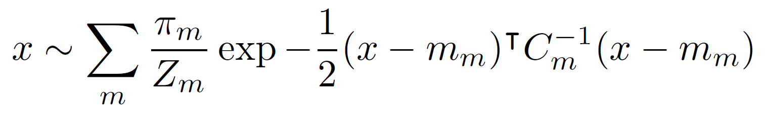
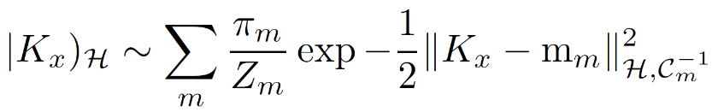
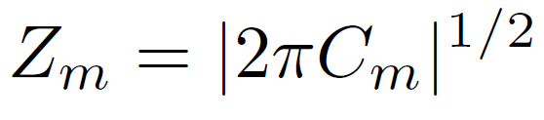
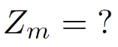

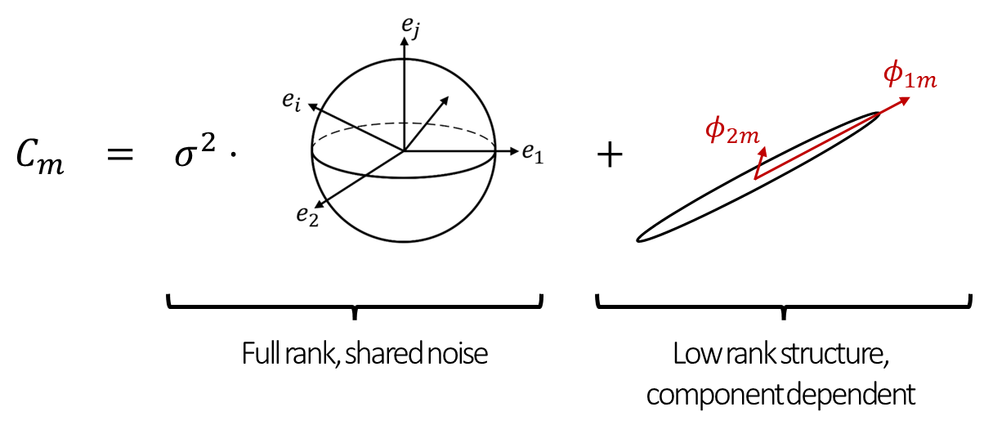
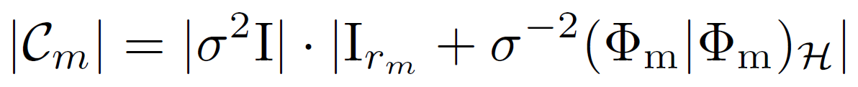

Mixture of kernel PCA: problem and solution intuition
Euclidean space
Kernel space
VB inference: iteratively update soft assignments and model parameters
Can’t compute soft assignments
Restricted covariance model: low-rank deviation from isotropic noise
Formally,
well-defined

Slide 10
Outline
Background on reproducing kernels
Probabilistic mixture of PCA in kernel space
Building shape spectral kernels

Slide 11
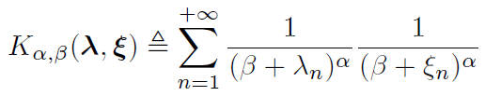
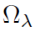
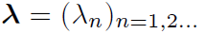
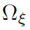

Shape spectral kernels
Parameters control scale
,
a shape with Laplace-Beltrami spectrum
,
a shape with Laplace-Beltrami spectrum

Slide 12





Spectral shape analysis
Shape retrieval
Group-wise analysis
Matching & transfer of shape / functional data
[From] Niethammer et al. Global medical shape analysis using the Laplace-Beltrami spectrum, MICCAI 2007
Shape dissimilarity metrics
[From] Bronstein et al. Shape Google: Geometric Words and Expressions for Invariant Shape Retrieval, ACM Trans Graph 2011
[Top] Lombaert et al. Brain transfer: Spectral analysis of cortical surfaces and functional maps, IPMI 2015
[Bottom] Ovsjanikov et al. Functional maps: a flexible representation of maps between shapes. ACM Trans Graph 2012
[From] Konukoglu et al. Discriminative segmentation-based evaluation through shape dissimilarity, IEEE TMI 2012

Slide 13



Intuition on spectral shape analysis
“Chladni figures”: sand on vibrating plates creates shape-dependent patterns for a countable set of shape-dependent resonance frequencies
From Wikipedia
Also true for heat diffusion [1], particle wave function (Schrödinger equation) [2]
Characterize a shape $Ω$ via the properties of differential operators defined on the domain $Ω$
The spectrum $λ={\left(λ_{n}\right)}_{n=1,2, …}$ of the Laplace-Beltrami operator $Δ_{Ω}$relates to geometrical invariants of $Ω$
[1] Reuter et al. Laplace-Beltrami spectra as Shape DNA of surfaces and solids, CAD 2006
[2] Aubry et al. The Wave Kernel Signature, ICCV workshops 2011

Slide 14











Laplace-Beltrami operator, spectrum and geometric invariants
Heat kernel
solves
Spectral decomposition of LB operator
spectrum
Heat-trace = link with the intrinsic geometry [1]
boundary
“diffusion” time
large $→$ global shape
small $→$ finer local patterns
$$φ_{1}$$
$$φ_{2}$$
$$φ_{5}$$
$$φ_{20}$$
$$φ_{50}$$
[Figure adapted from] Konukoglu et al. WESD – Weighted Spectral Distance for measuring shape dissimilarity, IEEE PAMI 2013.
[1] McKean and Singer. Curvature and the Eigenvalues of the Laplacian, Journal of Differential Geometry 1967.

Slide 15








Deriving spectral kernels from the heat-trace
Heat-trace
“diffusion” time
large $→$ global shape
small $→$ finer local patterns
[Adapted from] Konukoglu et al. WESD – Weighted Spectral Distance for measuring shape dissimilarity, IEEE PAMI 2013.
,
a shape with Laplace-Beltrami spectrum
,
a shape with Laplace-Beltrami spectrum
Influence on the heat-trace at time $t$ of the change $λ_{n}→ξ_{n}$
$$Δ_{α,β}^{n}\left(λ,ξ\right)=\int_{0}^{+∞}{}$$
$$⋅p_{α,β}\left(t\right)dt$$
Aggregate mode influences $→$ Hilbert norm
Family of Gamma distributions, figure adapted from Wikipedia

Slide 16
Shape spectral kernels
[MULTISCALE] Change $α,β→$ emphasize coarser scales or finer features. Subcases relate to WESD^{[1]} and Shape DNA^{[2]}
[EXISTENCE] Guaranties on the series convergence, analytic truncation error bounds
[STABILITY] The spectrum changes smoothly as the shape changes
[1] Konukoglu et al. WESD – Weighted Spectral Distance for measuring shape dissimilarity, IEEE PAMI 2013
[2] Reuter et al. Laplace-Beltrami spectra as Shape DNA of surfaces and solids, CAD 2006

Slide 17
Proof of concept

Slide 18











Leaf Shape database^{[1]} : unsupervised clustering of leaf species
69 binary images grouped in 10 different subtypes e.g.,
be
ce
de
ie
je
le
me
pe
(10)
(10)
(5)
(3)
(3)
(10)
(10)
(12)
Can we automatically retrieve the GT clusters above?
7 inferred clusters
Overlap with ground truth clusters: 71% ($±$1%)
Species with few examples (ie, je above) typically mislabelled
Gentle performance decrease w.r.t. scale parameters $α, β$: $≥$ 68% overlap across many parameter values
Stalk length
Missed the dents
[1] Database available at: imageprocessingplace.com. Developed by Vaibhav E. Waghmare, Govt. College of Engineering Aurangabad, 431 005 MS, INDIA

Slide 19
Leaf Shape database^{[1]} : unsupervised clustering of leaf species
69 binary images grouped in 10 different subtypes e.g.,
be
ce
de
ie
je
le
me
pe
(10)
(10)
(5)
(3)
(3)
(10)
(10)
(12)
Can we automatically retrieve the GT clusters above?
7 inferred clusters
Overlap with ground truth clusters: 71% ($±$1%)
Species with few examples (ie, je above) typically mislabelled
Gentle performance decrease w.r.t. scale parameters $α, β$: $≥$ 68% overlap across many parameter values
Stalk length
Missed the dents?
[1] Database available at: imageprocessingplace.com. Developed by Vaibhav E. Waghmare, Govt. College of Engineering Aurangabad, 431 005 MS, INDIA

Slide 20





LPBA40 dataset^{[1]}: clustering sub-cortical structures (caudate nuclei, hippocampi, putamina)
240 binary masks of subcortical structures (80 caudate nuclei, 80 hippocampi, 80 putamina)
Konukoglu et al. [2] present qualitative results obtained by non-linear embedding (ISOMAP) with WESD or shape-DNA metrics (figure below for reference)
Qualitatively similar “separation” of cortical structures with the proposed unsupervised clustering approach
16% average misclassification rate $(α=1, β=0)$, 6 main clusters (out of 10 maximum clusters) shown below
From [2]. Shape-DNA ISOMAP embedding
WESD ISOMAP embedding
Proposed mkPCA main cluster 2D projections. Circle $≡$ caudate, triangle $≡$ hippocampus, square $≡$ putamen. Large blue dots belong to the clusters; black dots do not (apparent overlap due to projection).
[1] Shattuck et al. Construction of a 3D probabilistic atlas of human cortical structures, NeuroImage 2008
[2] Konukoglu et al. WESD – Weighted Spectral Distance for measuring shape dissimilarity, IEEE PAMI 2013.

Slide 21




Sunnybrook cardiac dataset^{[1]}: learning left ventricle anomalies
45 left ventricle volumes: 24 heart failure (HF) subjects, 12 hypertrophic (HYP), 9 healthy (N).
HF modelled as a 2 component mkPCA, HYP and N as a 1 component mkPCA.
Maximum a posteriori classification of test subjects
Experimental setting:
Training on random fold of 2/3 of the dataset, testing on the complement.
Robustness analysis: 50 runs for each parameter setting.
Accuracy: proposed (75%$±$8%), volume-based mPCA (65%$±9$%), baseline at 53.3%
First eigenmode of HF/HYP clusters correlates resp. to volume of blood cavity/muscle
Examples with on average [Top] < 2% misclassification rate [Bottom] > 25% misclassification rate.
[Left] Default values, unless otherwise specified: $α=10, β={10}^{3}$and $σ^{2}$ set to 0.05% of the average k-means error. The first 3 blue columns modify $σ^{2}$ and the other 5 modify $α, β$
[1] Radau et al. Evaluation framework for algorithms segmenting short-axis cardiac MRI, MIDAS J. 49 2009

Slide 22



Conclusion & perspectives
Bayesian mixture of PCA in kernel space
Shape spectral kernels
Extends sparse mixture of PCA to non-trivial data types
Reproducing kernel encodes proximity/alignment of data points
Captures the intrinsic geometry, invariant to pose
Parametric family allows to adjust the scale of interest
“Can one hear the shape of a drum?” i.e. map back a spectrum to a shape
Not in the general case (isospectral non-congruent objects)
But biological structures vary smoothly
Isospectral objects

Slide 23




MSR Cambridge
Thank you!
More on InnerEye project:
Clustered AutoContext forests for Semantic segmentation
Decision Fields: Message Passing Forests for Segmentation

